Slide 1



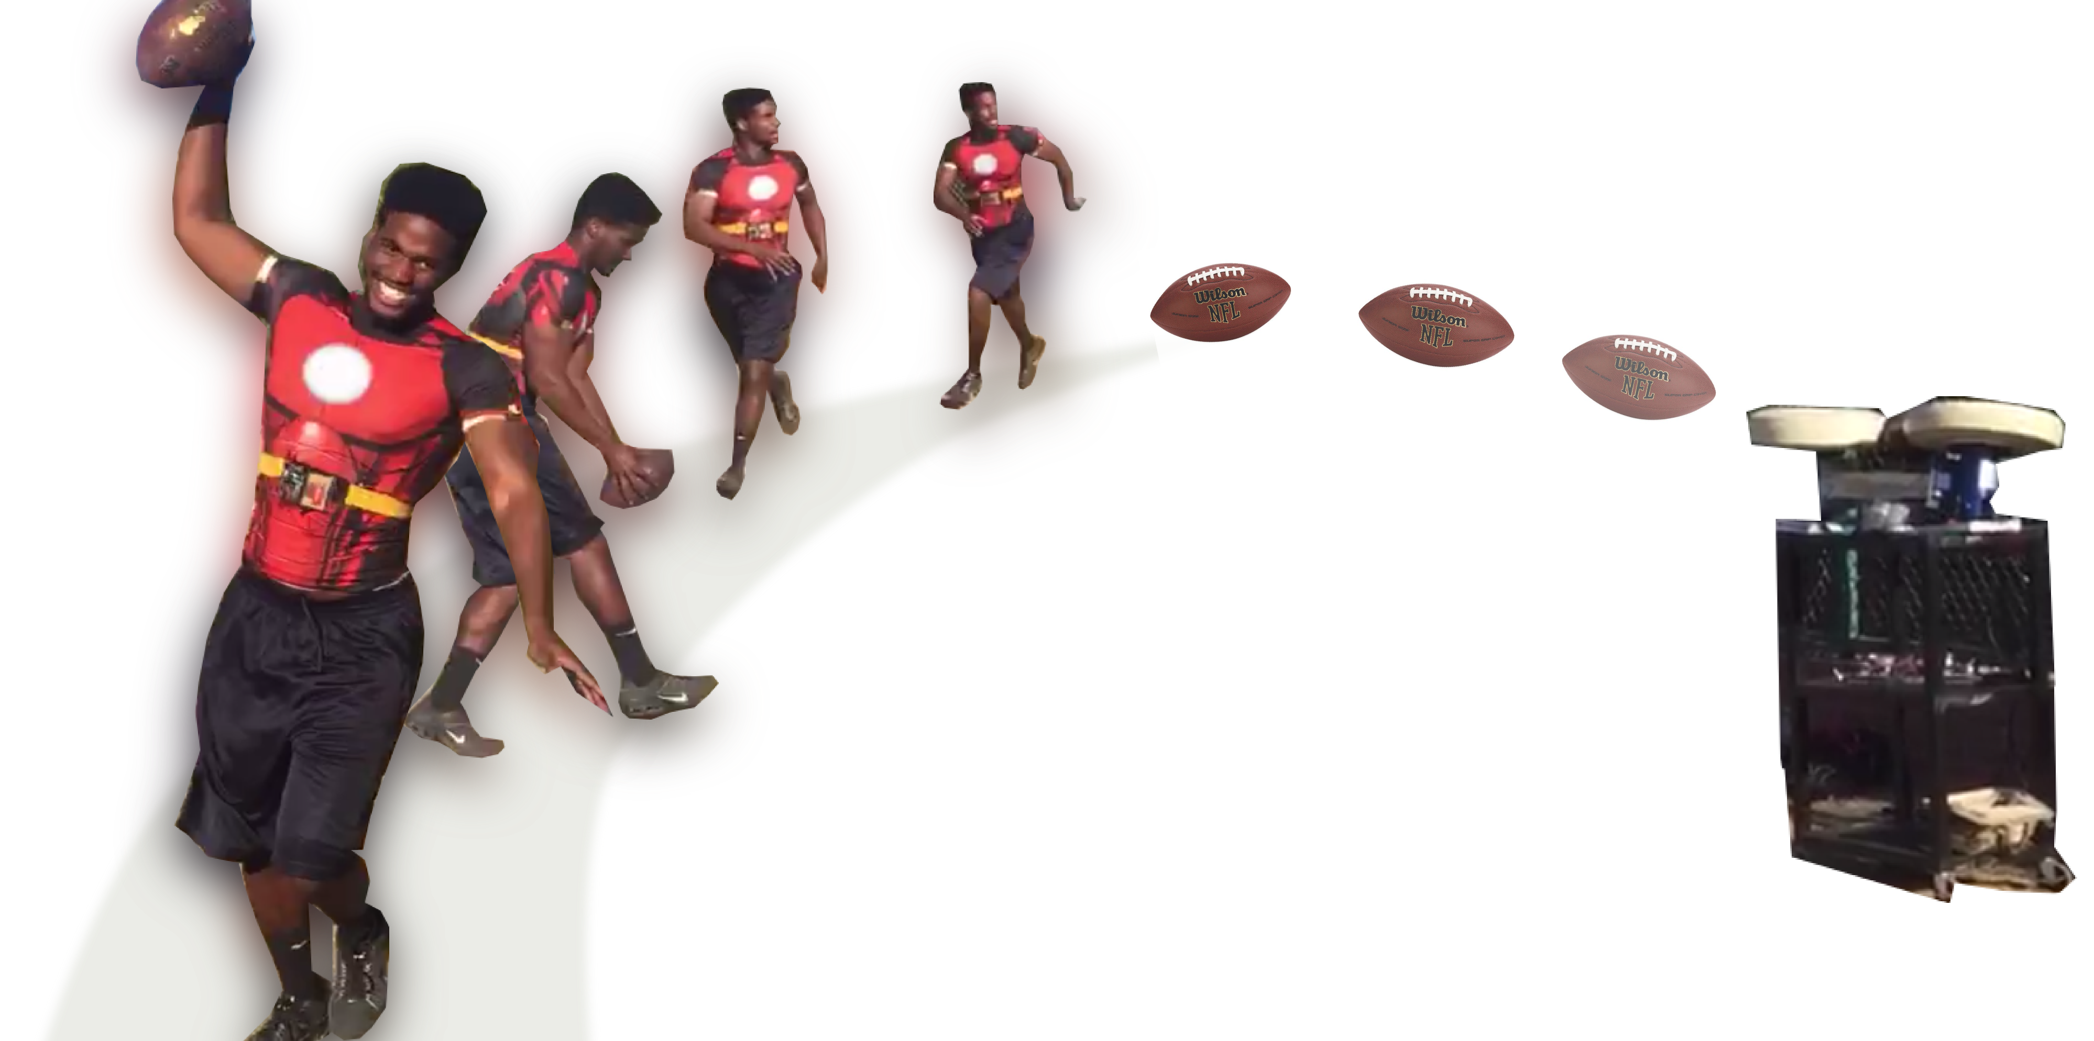
Autonomous Football Throwing Robot
Ricky Johnson
Mentor: Heni Ben Amor
NASA Space Grant Symposium
Arizona State University
04/22/2017

Slide 2
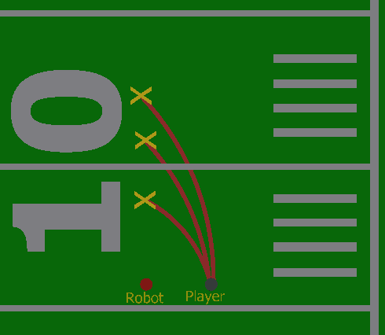
Objective
Create a robot that has the ability to track and throw a football to a player

Slide 3
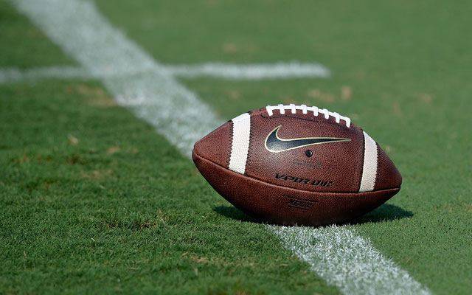
Bringing Player Development
&
Player Safety Together
Through Robotics

Slide 4
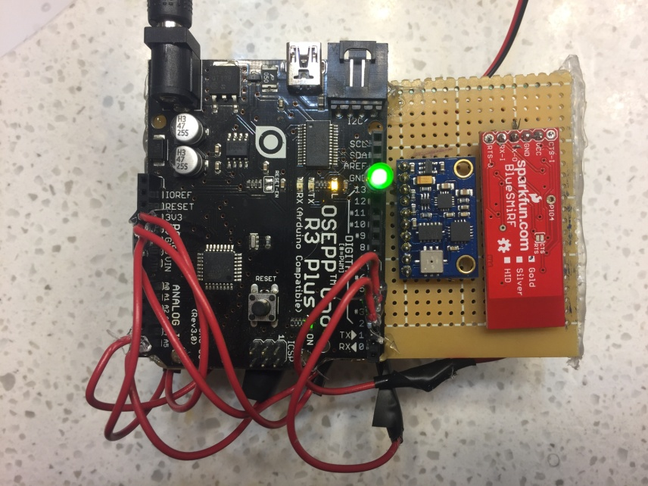
The Sensor

Slide 5
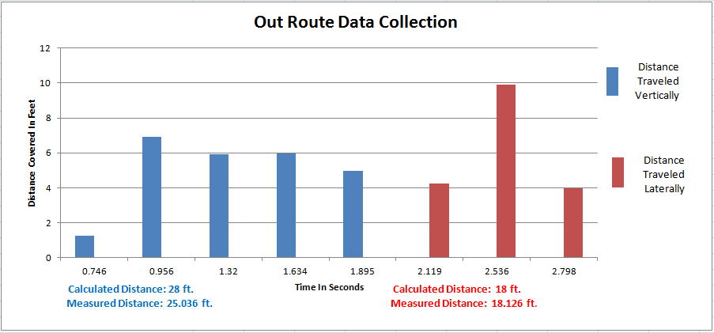
Sample Data From Accelerometer Readings

Slide 6
Results
7%
Tests with margin of error beyond +/- 3ft (4/54)

Slide 7
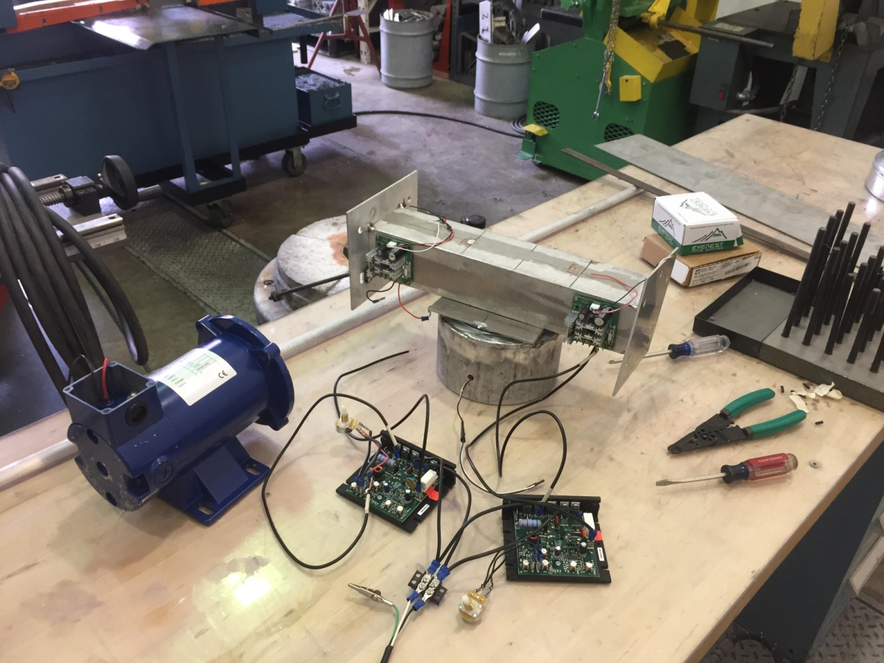
The Robot (Beginning Stages)

Slide 8
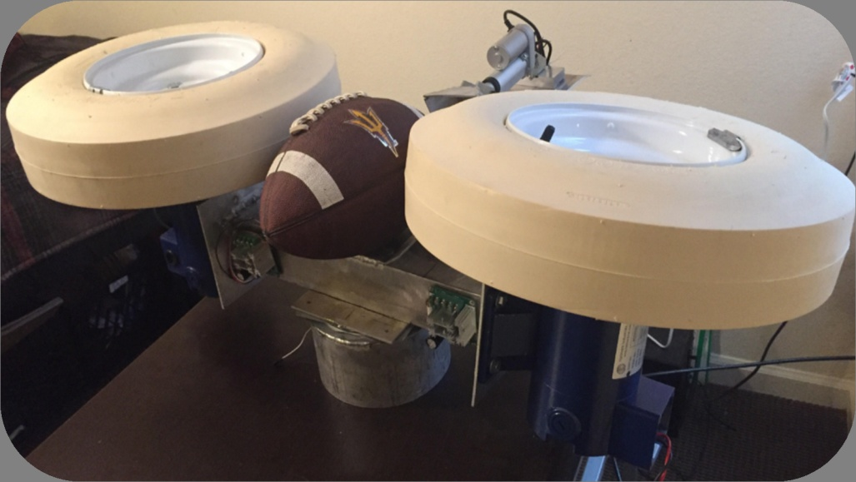
Assembled Stage

Slide 9
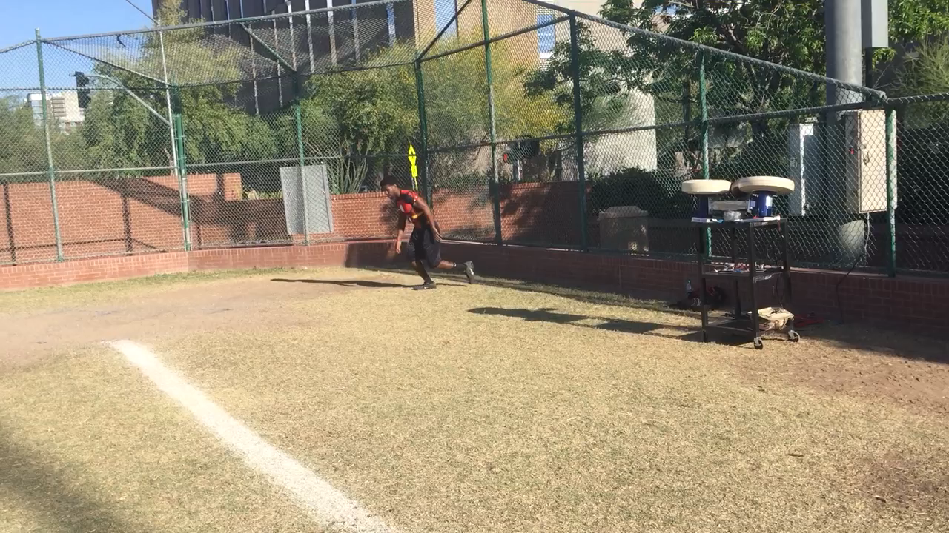

Slide 10
Results & Future Work
Designed and manufactured football throwing robot
Data-driven algorithms for human footstep recognition and tracking
Fully functional prototype of robot
Integration of team sensors
Reduction of input parameters
Next step: investigate patent opportunities

